Slide 1
Multiple disciplinary working for a shared goal – education, community and patience
Lead: UWTSD, EuroFIR, IFA
Notes:
Good morning Workkpackage 7 which is concerned with education training and support for FNSCloud

Slide 2

FNS-Cloud vision
FNS-Cloud will help overcome European research fragmentation by integrating and federating existing food nutrition security (FNS) data, tools and services, to provide added value FAIR data that can reduce knowledge gaps, facilitate better research and exploitation, inform policy, and help deliver sustainable diets to European citizens.
Food | Nutrition | Security | Cloud

Slide 3

FNS-Cloud mission
Implement and test cloud via Use Cases (WP4) and Demonstrators (WP5) to test existing and emerging data
Develop, integrate, and test innovative FNS Cloud tools and services
Enable harmonisation and standardisation of FNS data (sources, formats, languages) and external services (e.g., apps) to facilitate integration and interoperability
Engage FNS user communities (especially FNS researchers) to improve co-operation and reduce barriers to innovation and exploitation
Develop sustainable FNS Cloud governance and business models, in parallel with the wider EOSC user community
Food | Nutrition | Security | Cloud
About Us
www.fns-cloud.eu

Slide 4
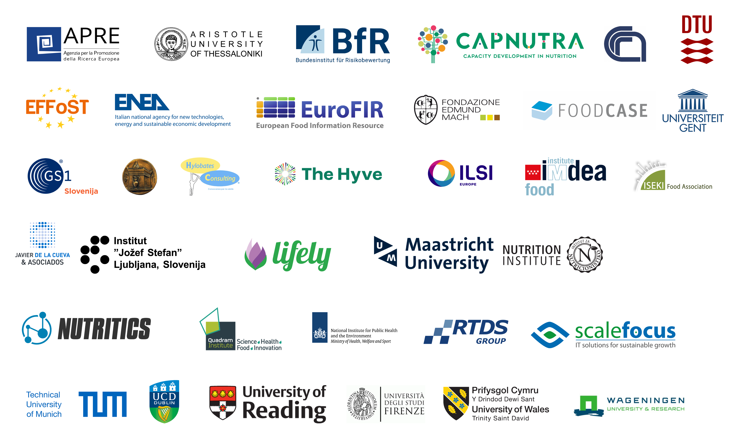
FNS-Cloud Consortium
Food | Nutrition | Security | Cloud
35 beneficiaries
11 EU Member States (AT, BE, BG, DE, DK, ES, GR, IE, IT, NL, and SI), UK, Serbia, & Switzerland
Research organisations including universities
For-profit and non-profit SMEs and Associations
IT specialists, FNS researchers and social scientists, lawyers, science communicators, multiplier organisations

Slide 5
Multiple disciplinary approaches
to working and research
Term | Description | Simple descriptors | Mathematical analogy | Food analogue
Multidisciplinary | Draws on knowledge from different disciplines but stays within the boundaries of those fields | Additive | 2+2=4 | Salad
Interdisciplinary | Analyses, synthesises and harmonises links between disciplines into a co-ordinated and coherent whole | Interactive | 2+2=5 | Cooking Pot
Transdisciplinary | Integrates the natural, social and health sciences in a humanities context, and in so doing transcends each of their traditional boundaries | Holistic | 2+2=yellow | Cake!
 |  | Choi & Pak (2006)

Slide 6
New institutional landscape of knowledge production
Multiple disciplinary work abounds in commercial, public and policy contexts within education, health, social work, justice service…
Environmental and agriculture, diet and health, computerised databanks and privacy – example of issues where many individuals or groups have some stake
New fields such as risk assessment, web of things etc are hybrid but relatively stable forms of knowledge which require collaboration (holistic or otherwise) between disciplines
Disciplinary identities, ‘competency card’, BUT team players are needed who can cooperate with experts from other fields and see the world from multiple perspectives and empathise with different presuppositions.
Team design and matrix management practices seek to harness the ‘better than the sum of the parts’ outputs

Slide 7


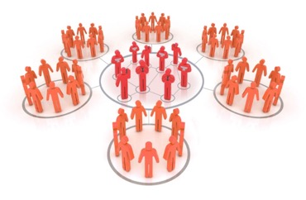



Building confidence
Collaboration visits
Training workshops
Consultation completed
Moved on-line and delivered
Finding novel ways to fund collaboration between consortium
Linked to all other WPs to provide
Train-the-initiator workshops for underpinning topics, e.g., open science
Online support for user communities
Resources supporting understanding and use of key exploitable results
Annual Conference
COP
elearning
Available in the 3rd and 4th years
Bespoke on-line
platform launched
Moving to external users
Dedicated elearning package
and advisor for all WPs to develop
sustainable resources for FNS Cloud users
Accredited
Development
PGC, MSc
for Users
Accreditation protocol completed to QAA standards allowing all training to be credit rated towards Masters and PGC

Slide 8
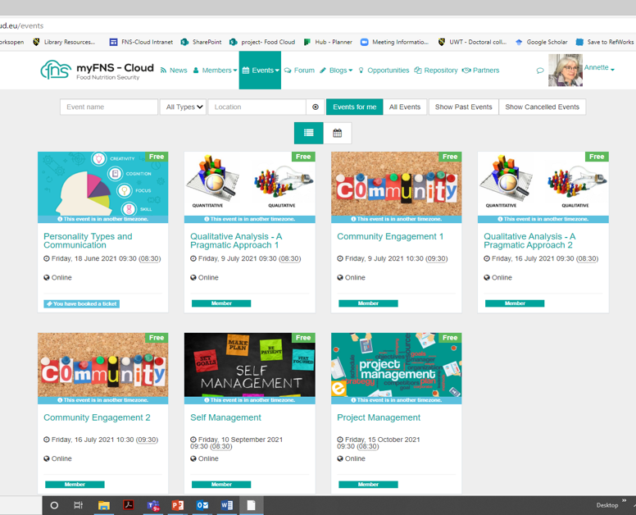
Develop Online Resources
Create and launch an FNS-Cloud Community of Practice (CoP), managed via the project website and a repository populated with elearning and social media designs and tools;
Initial work was providing resources and training to the project members
Now we move directly to the second phase – FNS community Networks and then the whole Community.
METROFOOD, proposed Food, Nutrition & Health-RI, Elixir Food and Nutrition Community, Comfocus, etc. to follow
Purpose: provide resources that allow user community to use FNS Cloud appropriately and easily

Slide 9
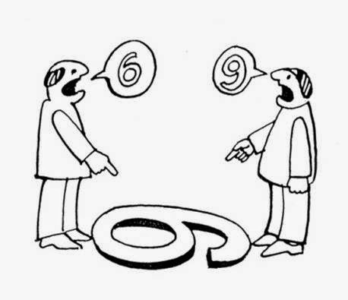
Learning to date -Patience
Communication barriers are cultural, social, as well as discipline based
Each discipline has their own construction of the issue at hand
This leads to lack of appreciation of each others working process, as well as amount of work needed for a task
This can change throughout the course of the project – for example when is a piece of work complete??
Co-construction requires continuous communication F2F , rechecking expectations and concerns.

Slide 10
FNS-Cloud Use Cases & Field Trials
Existing data, use cases to develop …
Food traceability & metrology search engine (milk, olive oil, fish) (ENEA, IT)
Food labelling data and reformulation tools (branded foods db) (NUTRIS, SI)
Total diet studies risk assessment (consumers, professionals) (RIVM, NL)
Food intake, consumer behaviour & lifestyle (mapping tool, merging strategies, data quality and usability assessment) (UCD, IE)
Lifestyle and NCDs cohort data (type 2 diabetes risk) (HUA, GR)
Emerging or no data, field trials to fill gaps …
Novel dietary intake and behaviour tools (24 h recall ethnic groups) (UCD, IE)
Novel dietary intake and behaviour tools (eNutri FFQ, elderly) (UoR, UK)
Family meal planning (Lifely, IT)
Healthy diets for healthy microbiome (QIB, UK)
Alert classification system for food-diet-drug interactions (IMDEA, ES)

Slide 11

FNS-Cloud Demonstrators
Bringing use cases and field trial data, knowledge, tools, and services together to answer research questions
Agri-food data and tools (DEM01) – traceability, metrology, labelling, (re)formulation, and benefit:risk
Nutrition & Lifestyle (DEM02) – intake, behaviour, purchase, preparation, consumption, and composition
Non-communicable diseases and microbiome (DEM03) – healthy diets, healthy microbiome, risk for T2D, food-drug interactions

Slide 12

www.fns-cloud.eu
Expected Impacts
Outputs of the project
Improved professional skills and competencies and confidence
Increased trans-national and trans-interdisciplinary exchange/ cooperation
Greater emphasis on user-communities and user-centred research outputs
Sustainability (cloud, users, potential to grow)
Scientific excellence globally and employments opportunities
Uptake of recommendations
Measurable increase in FNS data FAIRification
Facilitation of dialogue and exchange amongst user communities
Improved and more frequent exchange with stakeholders
Improved health in older adults, prolonging quality-of-life
Sustainable food chain generating safe, nutritious, affordable foods
10

